Slide 1
Peaceful coexistence, deterrence and active defense in China’s East China Sea strategy
Dennis J. Blasko, Independent Analyst
Liselotte Odgaard
Royal Danish Defence College
24 September 2013
Woodrow Wilson Center

Slide 2
Outline
The East China Sea issue
China’s maritime strategy: coexistence, deterrence and active defense
International and domestic reactions
4) Implications for regional security

Slide 3
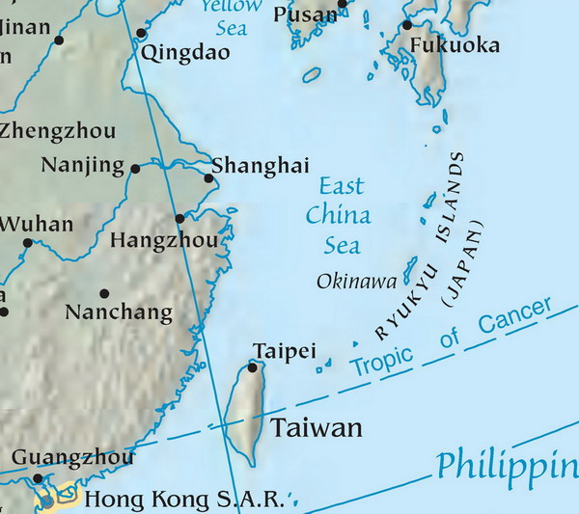
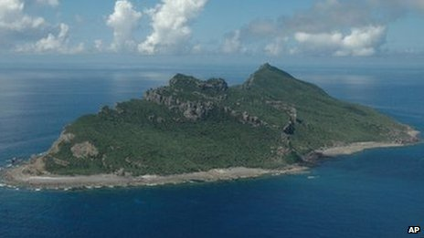
The East China Sea issue
The latest issue from the Chinese perspective:
Sept. 2012: Japanese government purchases disputed islands from a private Japanese citizen
Popular and governmental Chinese protests
Expansion of Chinese law enforcement and maritime military presence
Japanese monitoring of and publicizing of Chinese presence

Slide 4
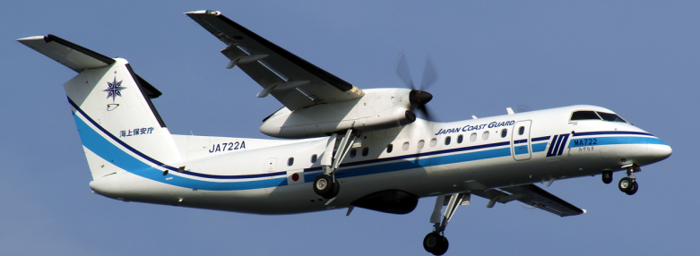
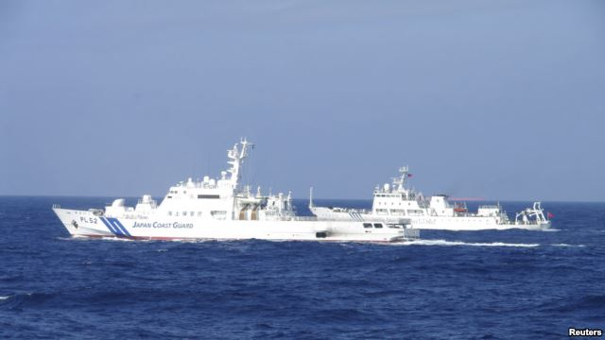
The East China Sea issue
Question:
To what extent are China’s objectives and strategy in the East China Sea changing the status quo in a way that contributes to escalation and the use of force
The claims:
China: The Diaoyu/Senkakus are ancient Chinese territory and disputes Japanese sovereignty
Japan: occupied terra nullius in 1895; no dispute exists
The US: acknowledges Japan’s administrative control and covered under the U.S.-Japan Security Treaty, but does not take a position on sovereignty issue

Slide 5
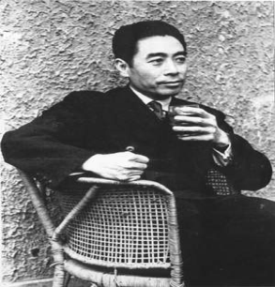
China’s maritime strategy
Grand strategy
Peaceful Coexistence
Objective: a greater
role in international
politics without jeopardizing relations with other states
Principles: mutual respect for sovereignty and territorial integrity, mutual non-aggression, non-interference, equality and mutual benefit, peaceful coexistence
Coexistence and sovereignty disputes: Change the status quo by changing the balance of power and the interpretation of international law without the use of deadly force

Slide 6
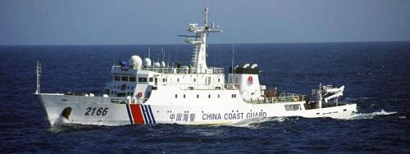
China’s maritime strategy
Coexistence in China’s East China Sea strategy:
Carve out space for China alongside US and Japanese presence by enhancing China’s civilian maritime force and by encouraging acceptance that states might subscribe to different interpretations of international maritime law
China’s “assertiveness” is perceived as bullying or aggression, but intended to protect perceived threats to long-standing claims of sovereignty

Slide 7
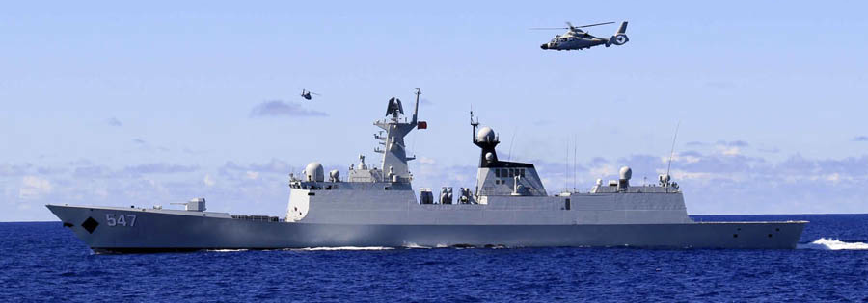
China’s maritime strategy
Active Defense: a component of Peaceful Coexistence
Active defense: defensive military posture based on striking only after the enemy has struck first
Active defense allows for:
Preemptive action to thwart an imminent attack
Offensive actions to be conducted as necessary throughout the course of military conflict
Active defense stresses the deterrence of war

Slide 8
China’s maritime strategy
“Warfighting and deterrence are two major functions of the armed forces.”
Deterrence: the comprehensive employment of military, political, economic, diplomatic, scientific and technological means to prevent war and to achieve strategic objectives, preferably without the use of force
Credible deterrence requires:
capable military forces
resolve to take action as necessary to defend China’s sovereignty and territorial integrity
deterred parties are made aware of China’s capabilities and resolve to use force when necessary
But, “imprudent decision to use force is never permitted”

Slide 9
Strategic timeline
China’s timelines for national economic modernization and military modernization are congruent with milestones at 2020 and completion date of 2049
Progress is measured by its “comprehensive national power” relative to other nations
Even with economic and military development, China’s senior leaders have not altered this timeline
Chinese leaders assess PLA has made absolute progress in its capabilities, but is still lagging in relative capabilities compared to advanced militaries
However, Beijing must contend with growing domestic nationalist pressures for China to assert its alleged rights

Slide 10
China’s maritime strategy
Deterrence and active defense in the East China Sea:
China’s deterrence posture was not sufficient to deter Tokyo’s actions in September 2012
Chinese reactions are portrayed to domestic and international audiences as legally justified because of Japanese provocations
Beijing employs primarily civilian (from the Maritime Police Bureau/China Coast Guard) and military capabilities to maintain a semi-permanent presence around the Senkaku/Diaoyu, demonstrating Chinese resolve to protect its territorial claims
China Coast Guard will receive new ships and retired navy vessels for law enforcement

Slide 11
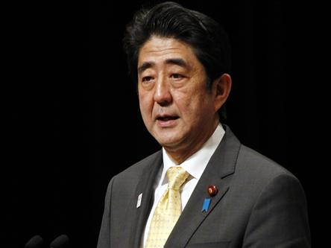
International and domestic reactions
Japan:
Reaction:
Does not acknowledge that the status quo has changed
Does not acknowledge that China has any rights in the vicinity of the Diaoyu/Senkakus
Does not try to force China out of the area
Domestic approval of heavy-handed approach presenting China as aggressive
Priorities:
Maintain undisputed sovereignty over Diaoyu/Senkakus
Maintain stable US-Japanese alliance relations
Stability

Slide 12

International and domestic reactions
US:
Reaction:
Does not acknowledge that the status quo has changed
Does not acknowledge that China has any rights in the vicinity of the Diaoyu/Senkakus
Monitoring from a distance
Presents China as aggressive and avoids criticizing Japan’s policy in public
Priorities:
Stability
Maintain stable US-Japan alliance relations
Improved relations with China

Slide 13
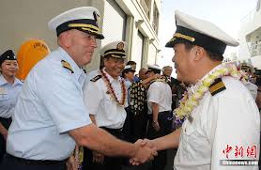
International and domestic reactions
China:
Reaction:
Streamlining lines of command within China’s maritime bureaucracy
Increased presence in the East China Sea to speed up change in balance of power
Domestic pressures for more assertiveness
Present Japanese actions as aggressive
Priorities:
Demonstrate ability to defend sovereignty
Stability
Maintain stable Sino-US relations

Slide 14
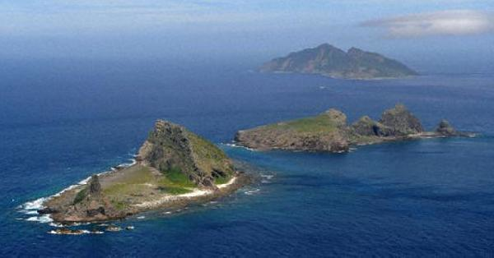
Implications for regional security
Results:
China is a de facto power in the East China Sea with a semi-permanent maritime civilian and military presence alongside the US and Japanese
Japan has trouble maintaining an equal presence with Chinese vessels and aircraft
Nationalism increases pressure on both governments
China has yet to achieve:
Legitimacy for its interpretation of international law
Outcome:
China is shifting the balance of power without persuading neighbouring states of its right to do so => contributes to escalation and conflict
A major use of force would signal a failure of China’s peaceful coexistence and active defense strategies

